Slide 1
Apache Kafka
Kanchana
BIG DATA and ML Developer
Feb 24th

Slide 2
Introduction to Kafka:
Apache Kafka is a distributed streaming platform.
Publish and subscribe to streams of records, similar to a message queue or enterprise messaging system.
Store streams of records in a fault-tolerant durable way.
Process streams of records as they occur.

Slide 3
Where exactly does it fit?
Building real-time streaming data pipelines that reliably get data between systems or applications
Building real-time streaming applications that transform or react to the streams of data

Slide 4
Few things before getting into kafka:
Kafka is run as a cluster on one or more servers that can span multiple datacenters.
The Kafka cluster stores streams of records in categories called topics.
Each record consists of a key, a value, and a timestamp.

Slide 5
How does Kafka's notion of streams compare to a traditional enterprise messaging system?

Slide 6
How does messaging normally work?
Messaging traditionally has two models:
Queuing : a pool of consumers may read from a server and each record goes to one of them
Publish-Subscribe: the record is broadcast to all consumers

Slide 7
How does a traditional messaging system work?
A traditional queue retains records in-order on the server, and if multiple consumers consume from the queue then the server hands out records in the order they are stored.
However, although the server hands out records in order, the records are delivered asynchronously to consumers, so they may arrive out of order on different consumers.
This effectively means the ordering of the records is lost in the presence of parallel consumption.
Messaging systems often work around this by having a notion of "exclusive consumer" that allows only one process to consume from a queue, but of course this means that there is no parallelism in processing.

Slide 8
Currently comparable traditional messaging system:
ActiveMQ or RabbitMQ
Kafka does it better

Slide 9
How does Kafka distributed messaging system work?
By having a notion of parallelism—the partition—within the topics, Kafka is able to provide both ordering guarantees and load balancing over a pool of consumer processes.
This is achieved by assigning the partitions in the topic to the consumers in the consumer group so that each partition is consumed by exactly one consumer in the group.
By doing this we ensure that the consumer is the only reader of that partition and consumes the data in order. Since there are many partitions this still balances the load over many consumer instances.
Note: However that there cannot be more consumer instances in a consumer group than partitions.

Slide 10
How does Kafka operate as a cluster to achieve distributed messaging?

Slide 11
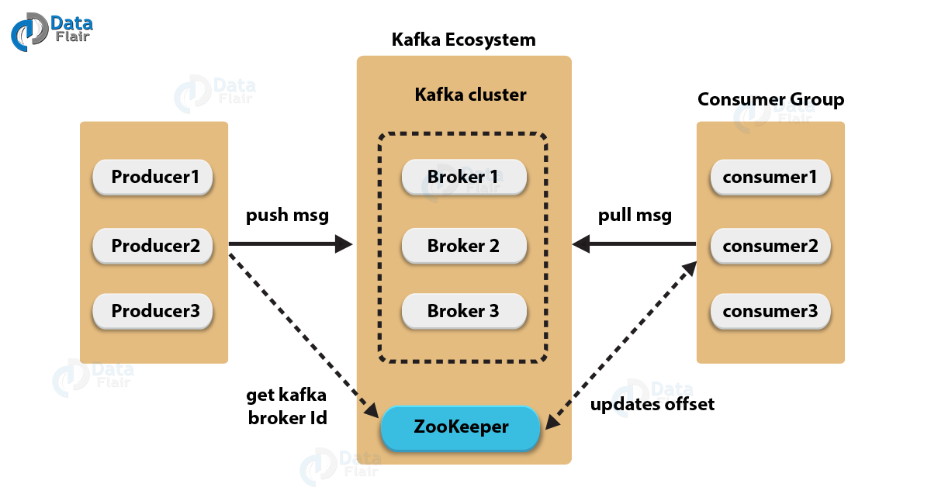
Apache Kafka Architecture – Cluster

Slide 12
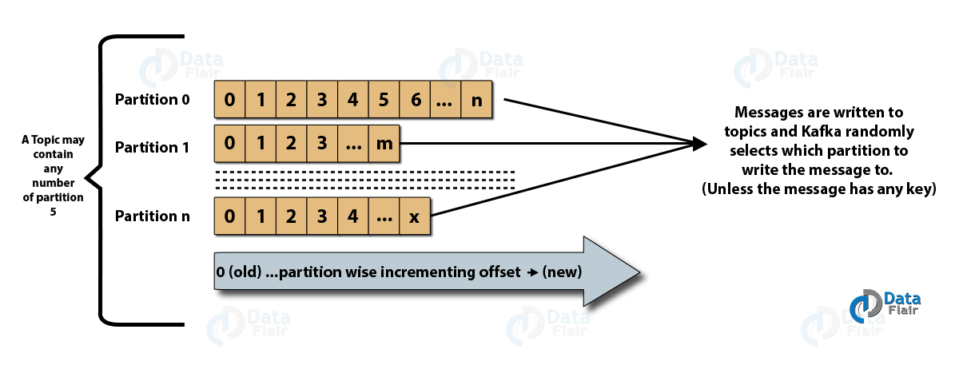
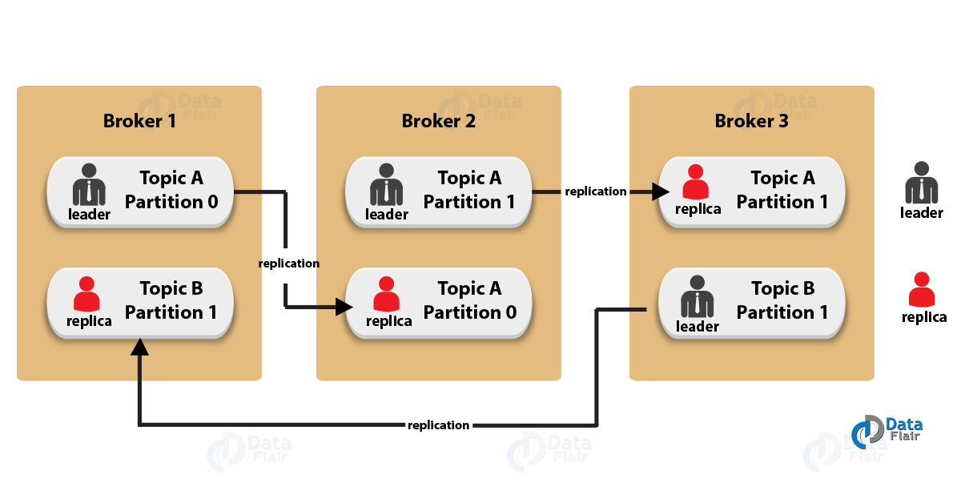
Kafka Architecture – Fundamental Concepts

Slide 13
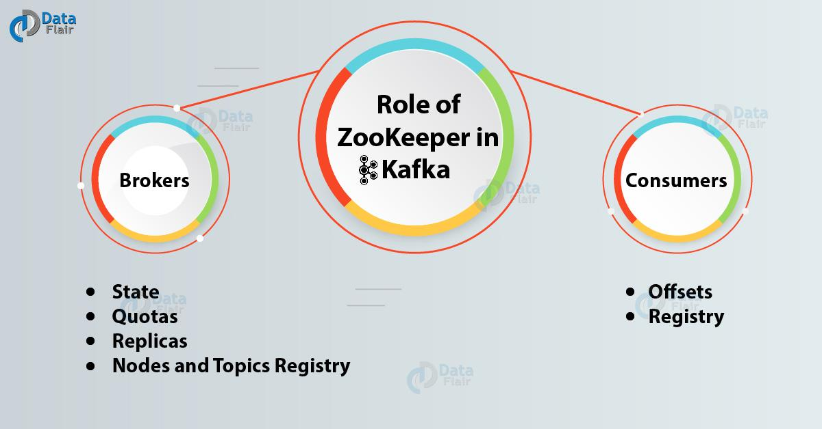
How does Kafka maintain all the information regarding the messages?

Slide 14
Kafka Use cases:
Website Activity Tracking
Metrics
Log Aggregation
Stream Processing
Event Sourcing
Commit Log

Slide 15
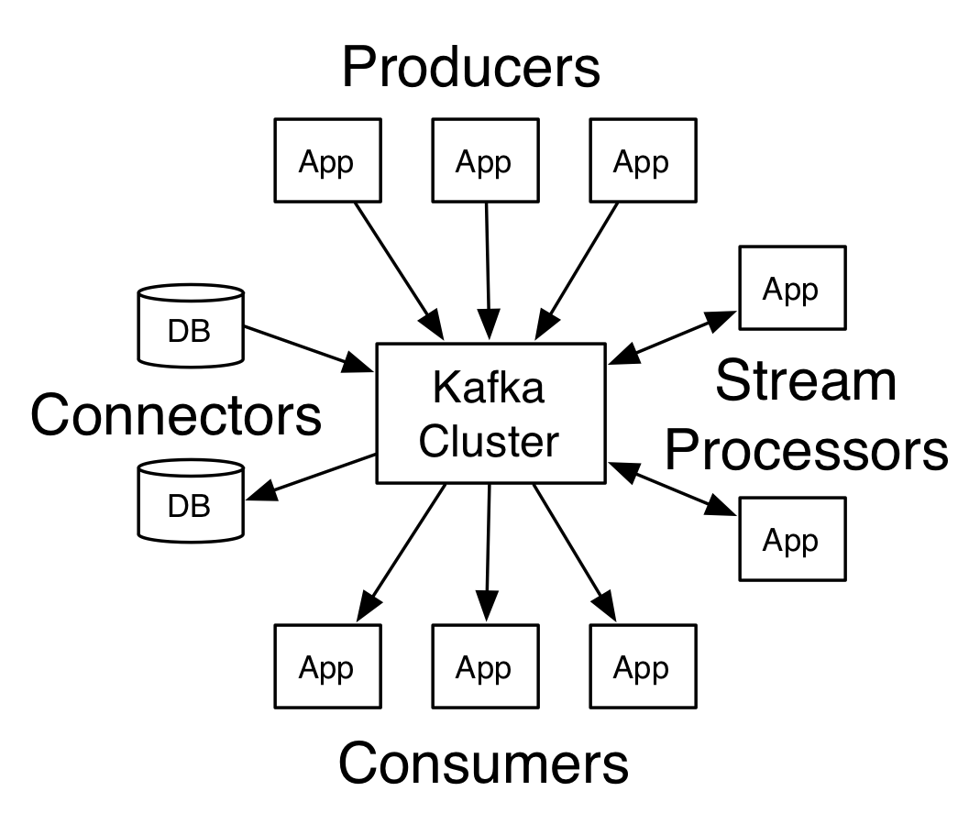
The core APIs in Kafka:
Producer API
Consumer API
Streams API
Connector API

Slide 16
Step 1: Download the code
Download the 2.4.0 release and un-tar it.
1 2 | > tar -xzf kafka_2.12-2.4.0.tgz > cd kafka_2.12-2.4.0
Step 2: Start the server
> bin/zookeeper-server-start.sh config/zookeeper.properties
Now start the Kafka server:
> bin/kafka-server-start.sh config/server.properties
Step 3: Create a topic
> bin/kafka-topics.sh --create --bootstrap-server localhost:9092 --replication-factor 1 --partitions 1 --topic test
Step 4: Send some
messages
> bin/kafka-console-producer.sh --broker-list localhost:9092 --topic test
This is a message
This is another message
Step 5: Start a consumer
> bin/kafka-console-consumer.sh --bootstrap-server localhost:9092 --topic test --from-beginning
This is a message
This is another message

Slide 17
Producer API:
Properties props = new Properties();
props.put("bootstrap.servers", "localhost:9092");
props.put("acks", "all");
props.put("key.serializer", "org.apache.kafka.common.serialization.StringSerializer");
props.put("value.serializer", "org.apache.kafka.common.serialization.StringSerializer");
Producer<String, String> producer = new KafkaProducer<>(props);
for (int i = 0; i < 100; i++)
producer.send(new ProducerRecord<String, String>("my-topic", Integer.toString(i), Integer.toString(i)));
producer.close();

Slide 18
Consumer API:
Properties props = new Properties();
props.setProperty("bootstrap.servers", "localhost:9092");
props.setProperty("group.id", "test");
props.setProperty("enable.auto.commit", "true");
props.setProperty("auto.commit.interval.ms", "1000");
props.setProperty("key.deserializer", "org.apache.kafka.common.serialization.StringDeserializer");
props.setProperty("value.deserializer", "org.apache.kafka.common.serialization.StringDeserializer");
KafkaConsumer<String, String> consumer = new KafkaConsumer<>(props);
consumer.subscribe(Arrays.asList("foo", "bar"));
while (true) {
ConsumerRecords<String, String> records = consumer.poll(Duration.ofMillis(100));
for (ConsumerRecord<String, String> record : records)
System.out.printf("offset = %d, key = %s, value = %s%n", record.offset(), record.key(), record.value());
}

Slide 19
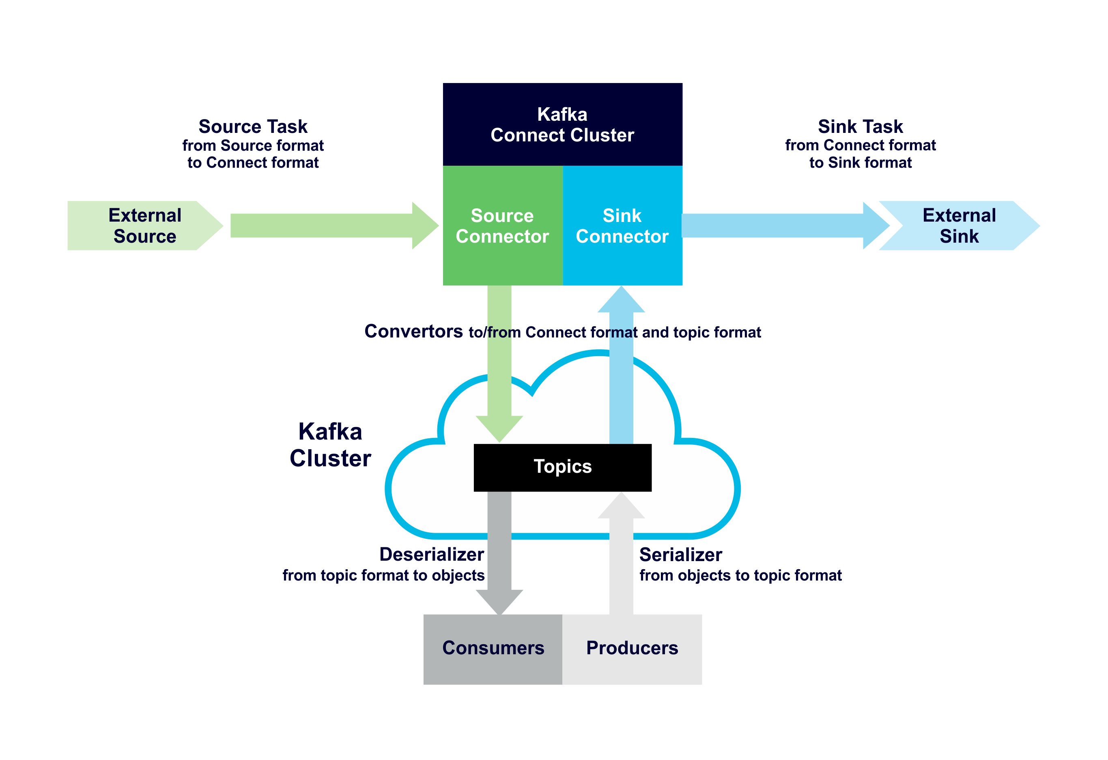
Kafka Connect:
Kafka Connect is intended to define bulk data copying jobs, such as copying an entire database rather than creating many jobs to copy each table individually.
continually pull from some source data system into Kafka or push from Kafka into some sink data system.

Slide 20
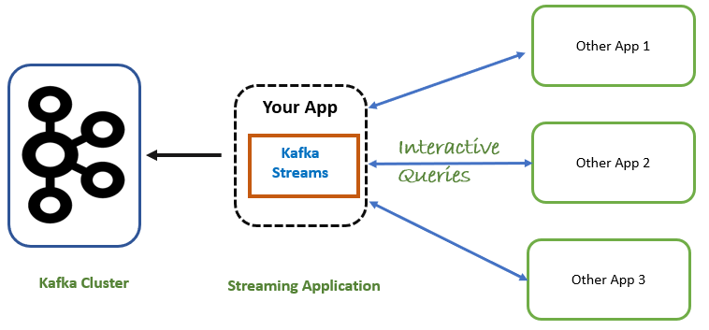
Kafka Streams:
Kafka Streams is a client library for processing and analyzing data stored in Kafka.
It builds upon important stream processing concepts such as properly distinguishing between event time and processing time, windowing support, exactly-once processing semantics and simple yet efficient management of application state.

Slide 21
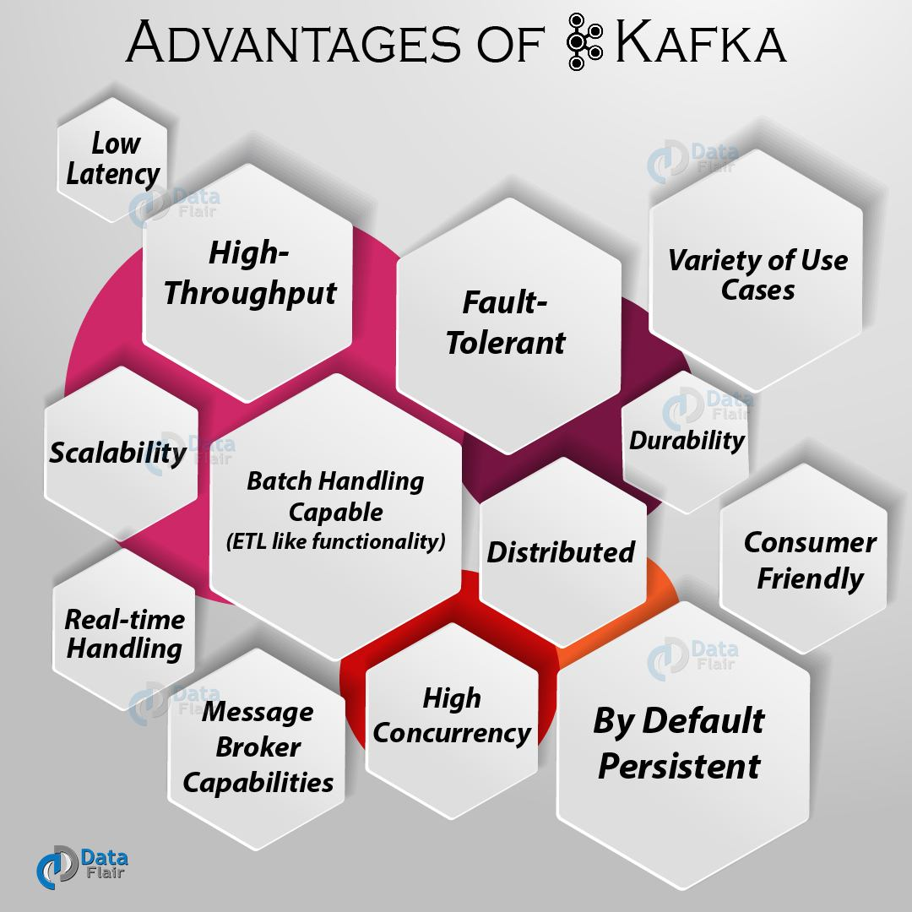

Slide 22

Thank you

